Slide 1
Moving from Transactional to Transformational Advising
Stefanie Crouse

Slide 2
Who we are vs. who we want to be
VS

Slide 3
Academic Advising at Montgomery County Community College
Medical model
Advisor = Primary care physician
Refer to “specialists”
Movement to SSIPP advising (CCRC)
Sustained, strategic, integrated, proactive, and personalized
Built upon RELATIONAL view of advising
What do you want to do?
What is the right major?
Where do you plan to transfer?
What is the best major at MCCC?
What classes should you take?

Slide 4
If I have done my job…
Notes:
So this is what the typical student experiences at institutions that are not providing supports in a holistic manner. Ping pong effect. Lots of places for students to leak out and we lose them forever.

Slide 5
Success!
Notes:
And their experience looks more like this. Notice that the blue and the green students have different supports offered to them.
In holistic student support, the supports are personalized for what the student needs at that time.
Personalized, seamless, and integrated.

Slide 6
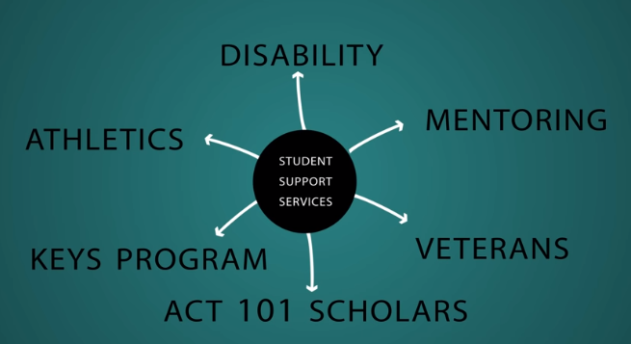
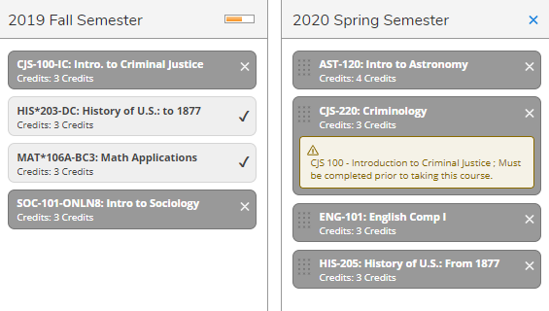
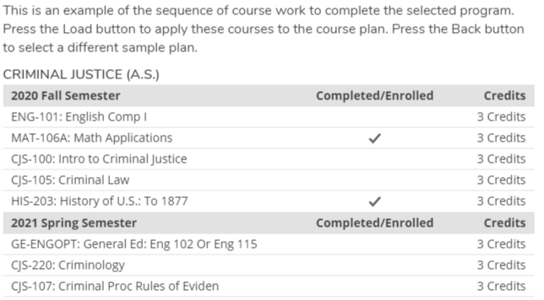
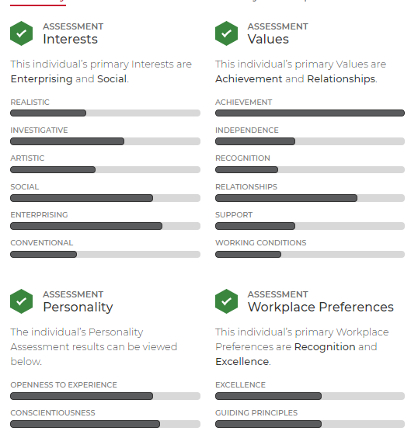
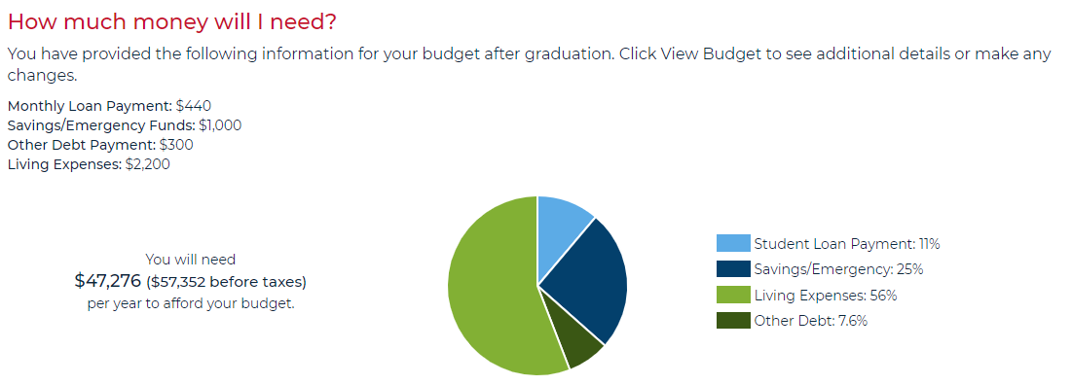
How we got there
Ready, Set, Montgo!
Ed. Planning
Career Planning
Templates
Starfish
v 2.0
Alerts
Financial Planning
Where we were in 2012
Where we want to be

Slide 7
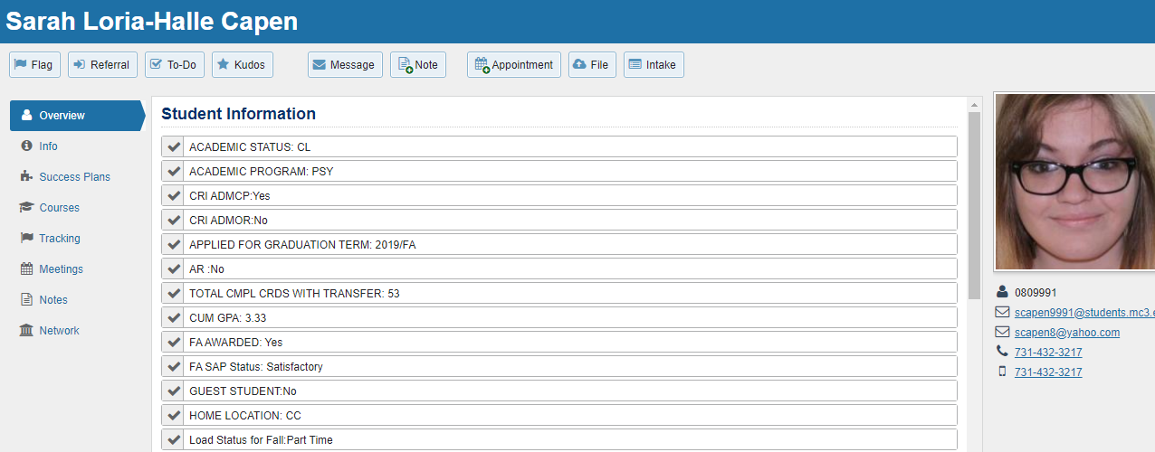
1st stop: Alerts (Starfish)

Slide 8
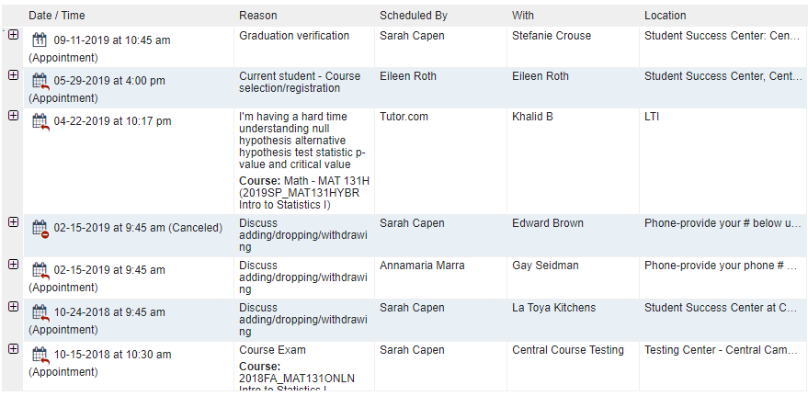
1st stop: Alerts (Starfish)
Advising
Tutoring
Testing

Slide 9
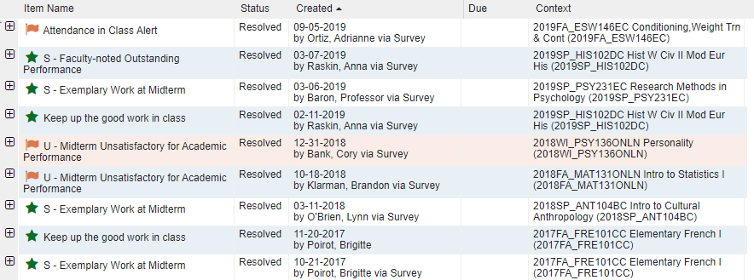
1st stop: Alerts (Starfish)

Slide 10
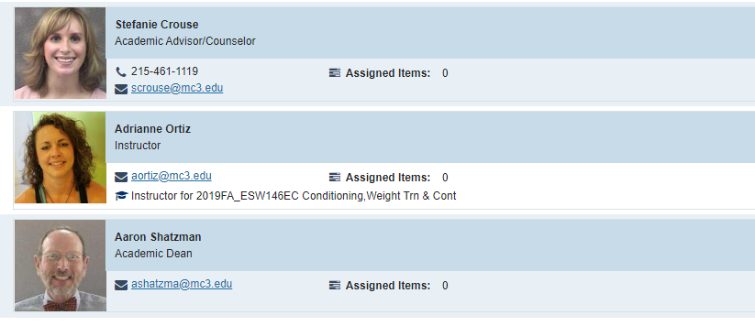
1st stop: Alerts (Starfish)

Slide 11
How we got there
Ready, Set, Montgo!
Ed. Planning
Career Planning
Templates
Starfish
v 2.0
Alerts
Financial Planning
Where we were in 2012
Where we want to be

Slide 12
2nd stop: Educational Planning (Ellucian)

Slide 13
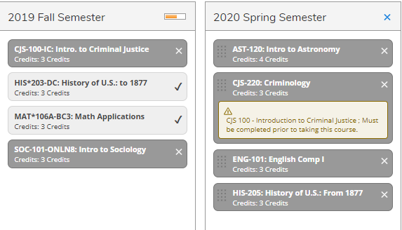
2nd stop: Educational Planning (Ellucian)

Slide 14
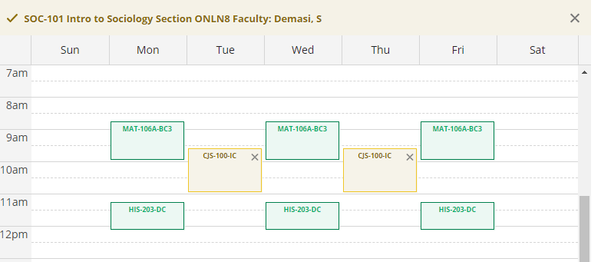
2nd stop: Educational Planning (Ellucian)

Slide 15
How we got there
Ready, Set, Montgo!
Ed. Planning
Career Planning
Templates
Starfish
v 2.0
Alerts
Financial Planning
Where we were in 2012
Where we want to be

Slide 16
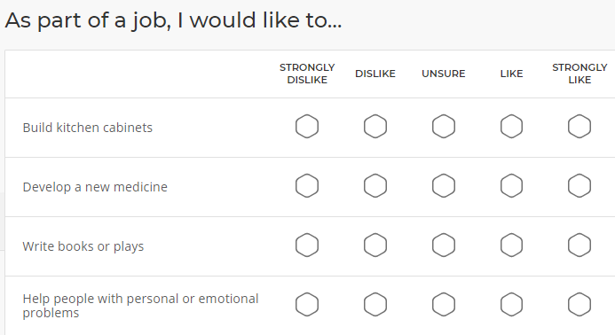
3rd stop: Career Planning (PathwayU powered by Jobzology)

Slide 17
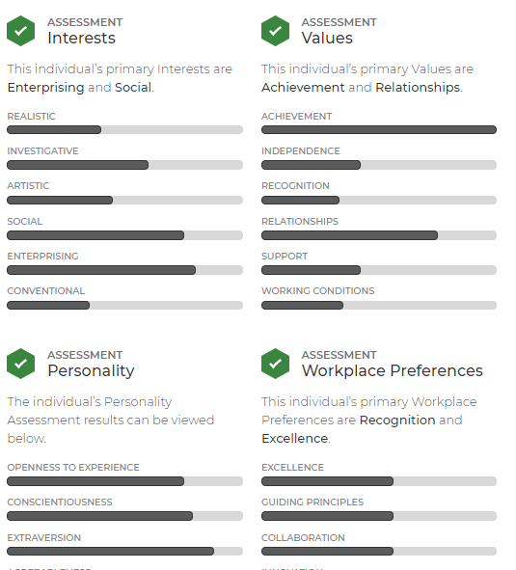
3rd stop: Career Planning (PathwayU powered by Jobzology)

Slide 18
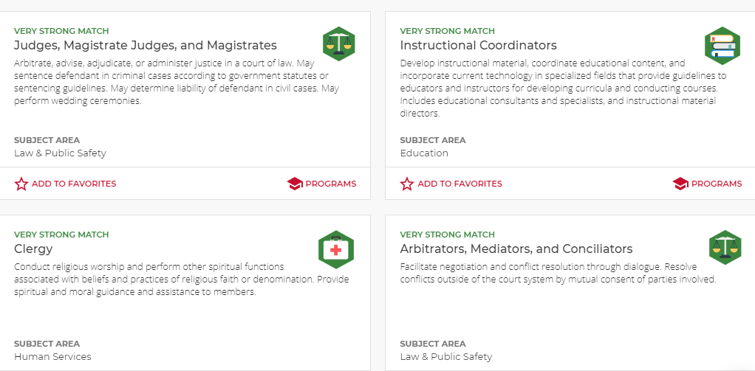
3rd stop: Career Planning (PathwayU powered by Jobzology)

Slide 19
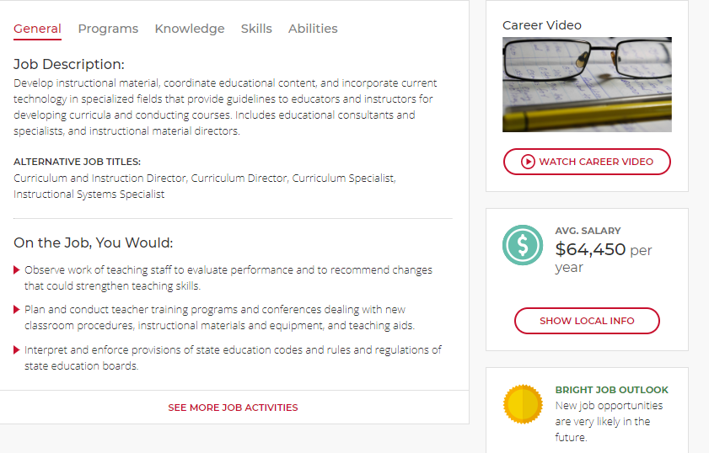
3rd stop: Career Planning (PathwayU powered by Jobzology)

Slide 20
How we got there
Ready, Set, Montgo!
Ed. Planning
Career Planning
Templates
Starfish
v 2.0
Alerts
Financial Planning
Where we were in 2012
Where we want to be

Slide 21
4th stop: Financial Planning

Slide 22
4th stop: Financial Planning

Slide 23
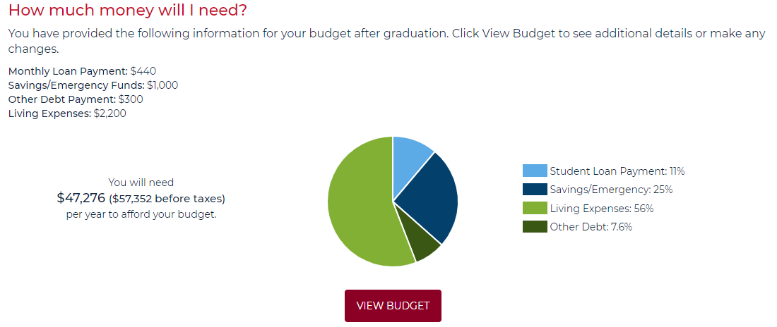
4th stop: Financial Planning

Slide 24
4th stop: Financial Planning

Slide 25
How we got there
Ready, Set, Montgo!
Ed. Planning
Career Planning
Templates
Starfish
v 2.0
Alerts
Financial Planning
Where we were in 2012
Where we want to be

Slide 26
5th stop: Starfish v2.0

Slide 27
5th stop: Starfish v2.0

Slide 28
5th stop: Starfish v2.0
Attendance reporting
Early alert survey
Midterm reporting

Slide 29
How we got there
Ready, Set, Montgo!
Ed. Planning
Career Planning
Templates
Starfish
v 2.0
Alerts
Financial Planning
Where we were in 2012
Where we want to be

Slide 30
6th stop: Ready, Set, Montgo
Align
Assess
Advise
6 minute video +
Intake form
One-on-one appointment with an advisor

Slide 31
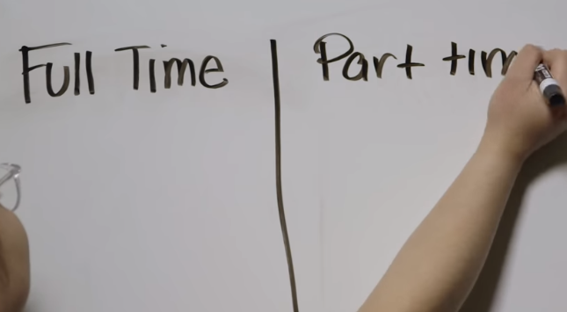
6th stop: Ready, Set, Montgo
https://www.mc3.edu/admissions/applying-to-mccc/ready-set-montgo

Slide 32
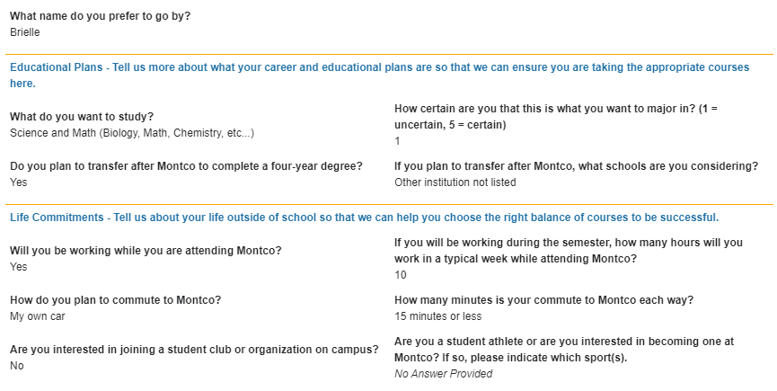
6th stop: Ready, Set, Montgo

Slide 33
How we got there
Ready, Set, Montgo!
Ed. Planning
Career Planning
Templates
Starfish
v 2.0
Alerts
Financial Planning
Where we were in 2012
Where we want to be

Slide 34
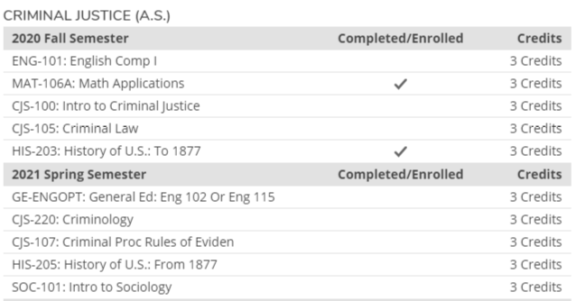
7th stop: Templates (Ed Planning v2.0)

Slide 35
7th stop: Templates (Ed Planning v2.0)

Slide 36
But we’re still not there…
Ready, Set, Montgo!
Ed. Planning
Career Planning
Templates
Starfish
v 2.0
Alerts
Financial Planning
Where we were in 2012
Where we want to be

