Slide 1
Using Design Thinking for Advising Redesign with the end in mind
Stefanie Crouse

Slide 2
A little bit of background
Surburban campus located 20 miles northwest from Philadelphia, PA
>10,000 registered for the fall semester
8% at our Virtual Campus
16% at our West Campus
75% at our Central Campus
23 academic advisors
Professional advisors, but non-teaching faculty
8 advisors at the College for 15+ years
6 advisors at the College for 9 -15 years
9 advisors at the College for 1-8 years
Students
Declining student population
Shift to part-time population (70%)

Slide 3
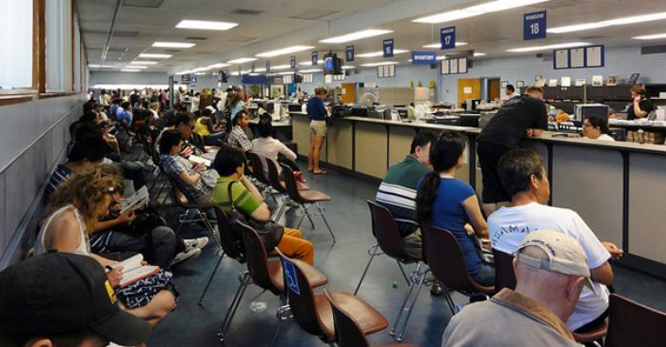
Student Experience in the past
Walk in culture
First come first service
Transactional not relational
Once and done
Chasm between student affairs and academic affairs
Some version of career exploration tool
“Seeds” of current evolution
Some “experts” in certain areas
Very basic note taking system

Slide 5
Student
Advising
Academic Affairs
Enrollment Services
On-
boarding

Slide 6
Empathize
Step 1

Slide 7
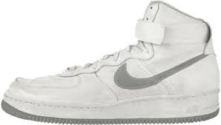
Design Thinking Example: Nike
“We’re listening to athletes about ways that shoes impact performance, but also hearing about their passion for luxury materials,” says Fenech, Nike’s senior brand director for North America. “We’ve merged the two, responding to their day-to-day needs, as well as their style inspiration.”
https://www.fastcompany.com/3068182/how-nike-became-a-fashion-powerhouse

Slide 8
Empathize: Seek to understand

Slide 9
Team time #1
What specific ways could you gather information about your student experience?
What would you want your child’s advising experience to be like – or your mom’s?

Slide 10
Define
Step 2

Slide 11
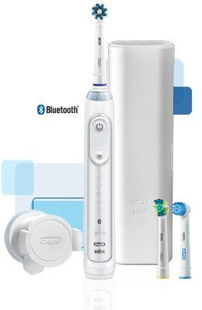
Design Thinking Example: Braun/Oral-B
“When Braun and Oral-B enlisted Colin and Hecht to help them come up with an IoT electric toothbrush, the manufacturers initially wanted to develop a sophisticated data-tracking tool that could sense how well users were brushing each and every tooth, tell them about their gum sensitivity, and play music. The designers convinced them to instead think about how additional technology could solve a couple of really big frustrations with the product.”
https://www.fastcompany.com/3060197/how-two-industrial-design-titans-are-helping-brands-simplify-tech

Slide 12
Define: Identify your problem
Increase retention?
Increase # of credits taken each semester?
Increase graduation rates?
Decrease D/W/Fs?
Increase FAFSA completion rates?
Improve transfer process?
Decrease changes of major?
Help to resolve basic needs?
Decrease # of credits upon graduation?

Slide 13
Team time #2
‘If _______ could change at my school, I know my students could be more successful.”

Slide 14
IDeate
Step 3

Slide 15
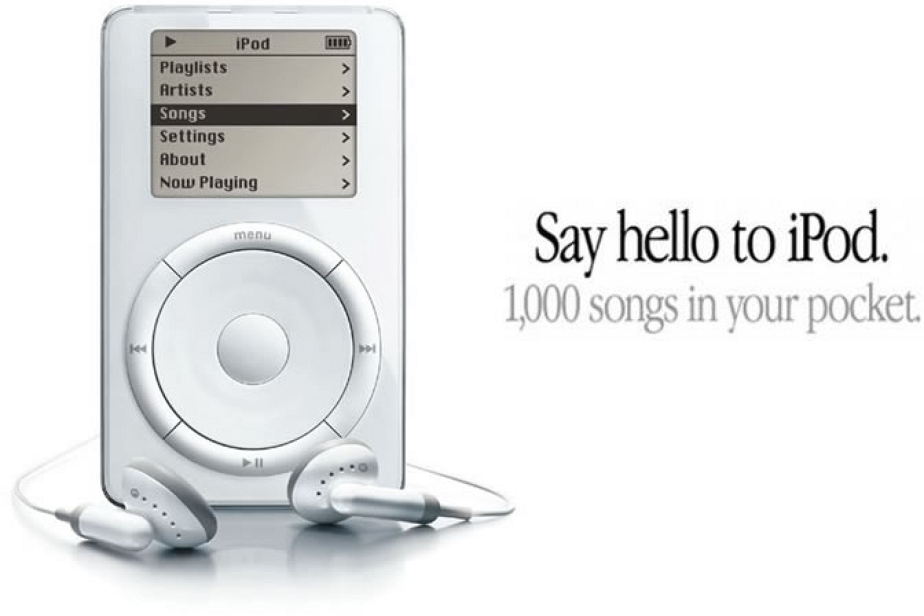
Design Thinking Example: Apple
“Sometimes when you innovate, you make mistakes. It is best to admit them quickly, and get on with improving your other innovations.” – Steve Jobs

Slide 16
Ideate: More is better!
Predictive analytics
Enrollment coaches
Group advising
Early alerts
C
Educational planning
C
Financial planning
Career planning
Program of study advising
C
C

Slide 17
Team time #3
Take 10 minutes and come up with as many possible solutions – both big and small – that would change your students’ experience.

Slide 18
Prototype and test
Steps 4 and 5

Slide 19
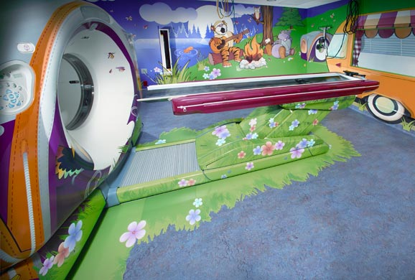
Design Thinking Example: GE Healthcare
“Children pick up on their parent’s reactions when they enter the room, and the setting makes them all feel at ease. ‘I know for sure, if you’ve got the child, you’ve got the parent. If you’ve got the parent, you can get the child, because they are always looking for that reaction.’”
http://newsroom.gehealthcare.com/from-terrifying-to-terrific-creative-journey-of-the-adventure-series/

Slide 20
Prototype and Testing: Out of your head. Fail fast.
Video orientation
Group orientation
New Student Days
Longer advising appts
Cluster orientation

Slide 21
Who is around your table?
Student Affairs
Dean of Student Affairs
Advising
IT
Executive Directors
Manager of Digital Usability
Enrollment Services
Directors of Enrollment Management, Operations, Testing Center
Student Life
Financial aid
Marketing
Director of Marketing
Digital Marketing Manager

Slide 22
Team time #4
Most importantly, who will be around your table through this process?

Slide 23
Humble Brag

